Slide 1
Terrain generation by iterative process
Overleaf link : https://www.overleaf.com/9817881829vdswhfvpkzww

Slide 2
Main pipeline
Initial terrain generation
Iterative augmentation
Final augmentations

Slide 3
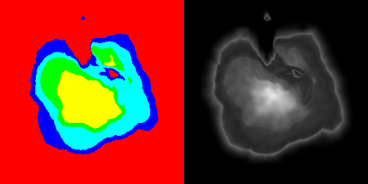
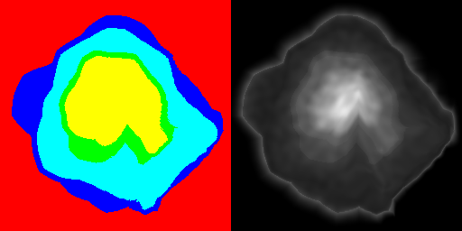
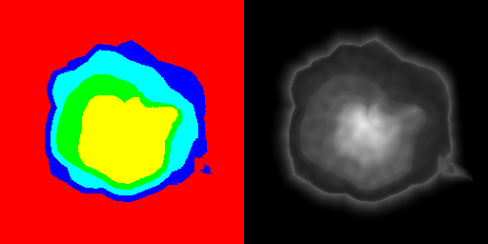
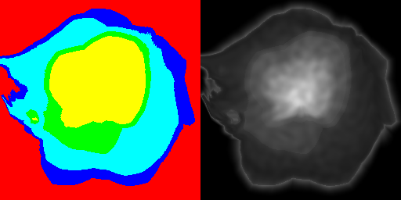
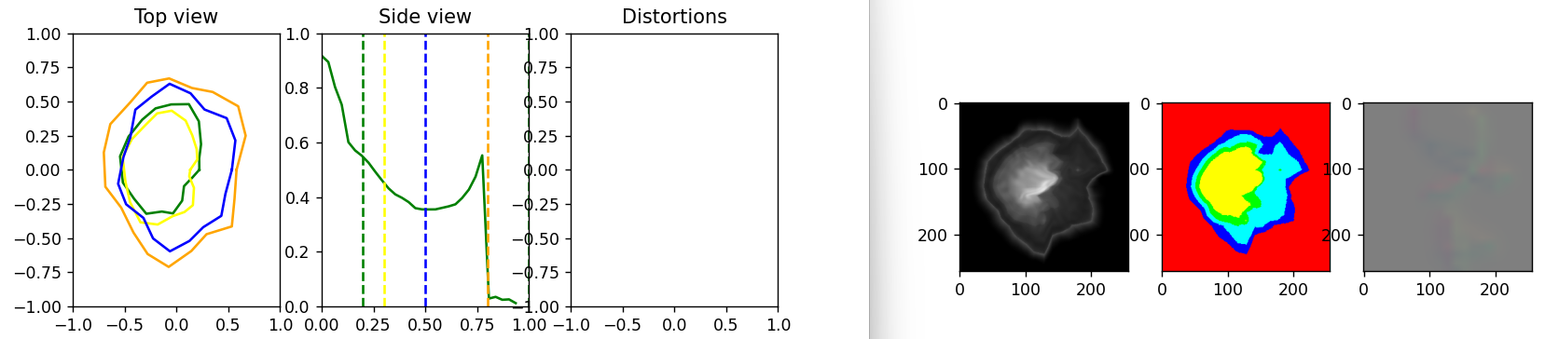
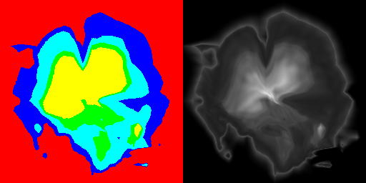
Initial terrain generation Possible solution: Deep learning
Creation of a synthetic terrain dataset from top-view and side-view sketches + distorsions from vector field
Outputs: heightmap + labeled image
Use of out-of-the-box cGAN («pix2pix») for interactive generation
Related work: Guerin et al. «Interactive Example-Based Terrain Authoring with Conditional Generative Adversarial Networks» (2017)
But without any code required and very low learning time (transfer learning)

Slide 4
Iterative augmentation
Process:
Compute properties at surface (depth, normals, water flow, and distance to other structures)
Find best fitting generation rule
Instantiate new structure
Repeat

Slide 5
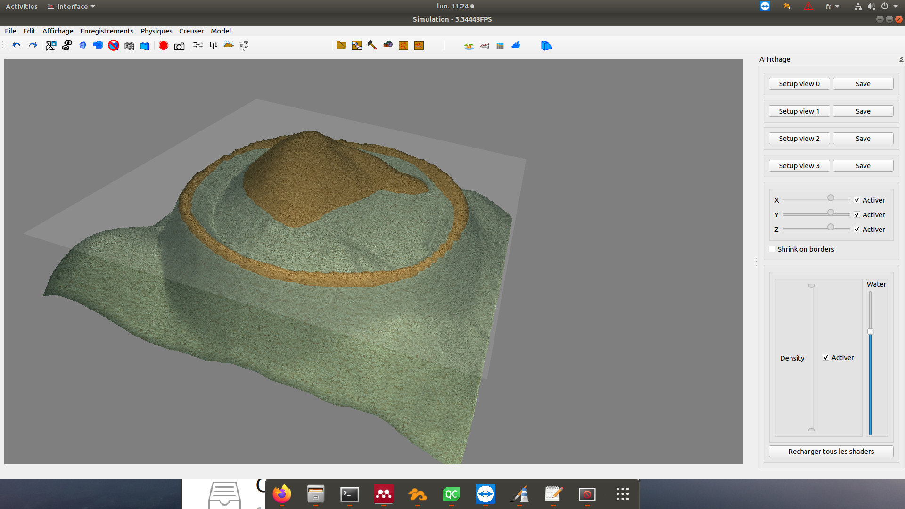

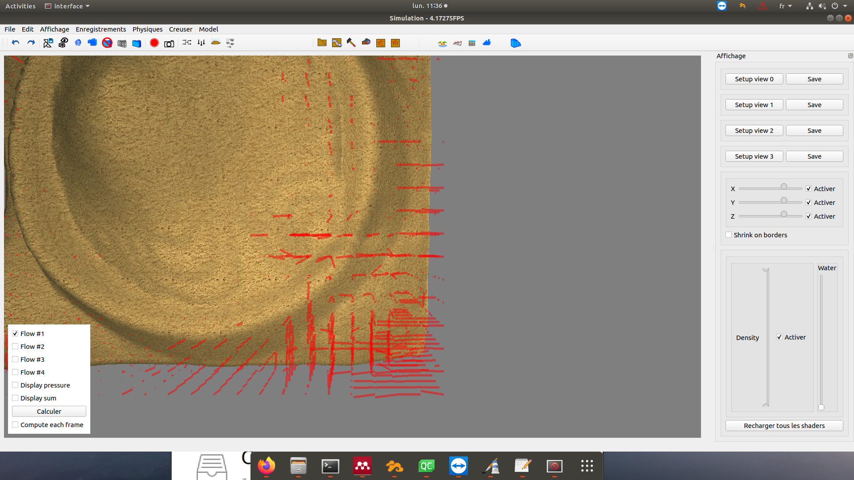
Iterative augmentation – best fitting rule
Compute a score at each point of the surface based on the defined rules
Here, used a completely ad-hoc fitting function to minimize
(Should be also compared with the score of all other rules)
Compute best fitting score
Instantiate structure (here, «passe»)
Direct effect on the water flow computation

Slide 6
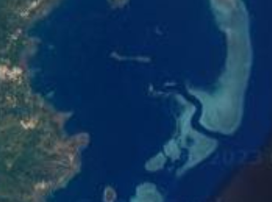
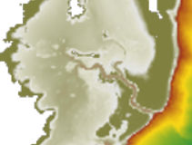
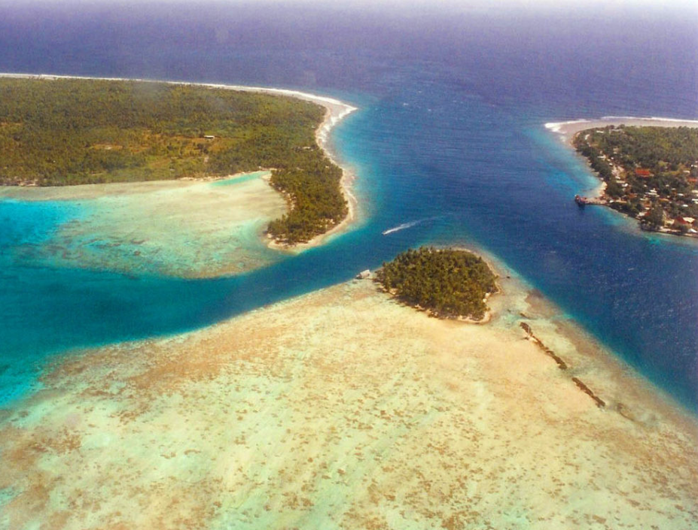
Iterative augmentation – current state
Everything is hard-coded, different rules don’t «compete» yet
3 first cases to create :
Passe, Delta, Motu
Once those are done, I’m confident we have everything for many other structures (≠ coral areas, water inlets, caves, coral boulders, fractures, sand beds, etc.)

Slide 7
Final augmentation
3D erosion process based on water flow
Coral models instantiation from the gen. rules

